Slide 1
FaceVision
Terralogic Software Solutions Pvt. Ltd.
-By Kalpesh Anil Dahake

Slide 2

Introduction
The project focuses on face detection using OpenCV and Haar cascades. It involves detecting faces in images and drawing rectangles around them. Initially, the project reads an image and displays its shape. It then resizes the image and converts it to grayscale for better processing. The Haar cascade classifier is used to detect faces in the image, and the detected faces are highlighted with rectangles. The project also demonstrates the detection of eyes using a separate Haar cascade classifier. Overall, the project provides a basic implementation of face detection using Haar cascades in OpenCV.
This project utilizes OpenCV and Haar cascades for face detection. It reads an image, resizes and converts it to grayscale, and detects faces using a Haar cascade classifier. The detected faces are highlighted with rectangles. Additionally, the project demonstrates the detection of eyes using a separate Haar cascade classifier. It provides a simple and fundamental implementation of face detection, which can serve as a starting point for more complex computer vision applications involving face recognition, tracking, or analysis.

Slide 3
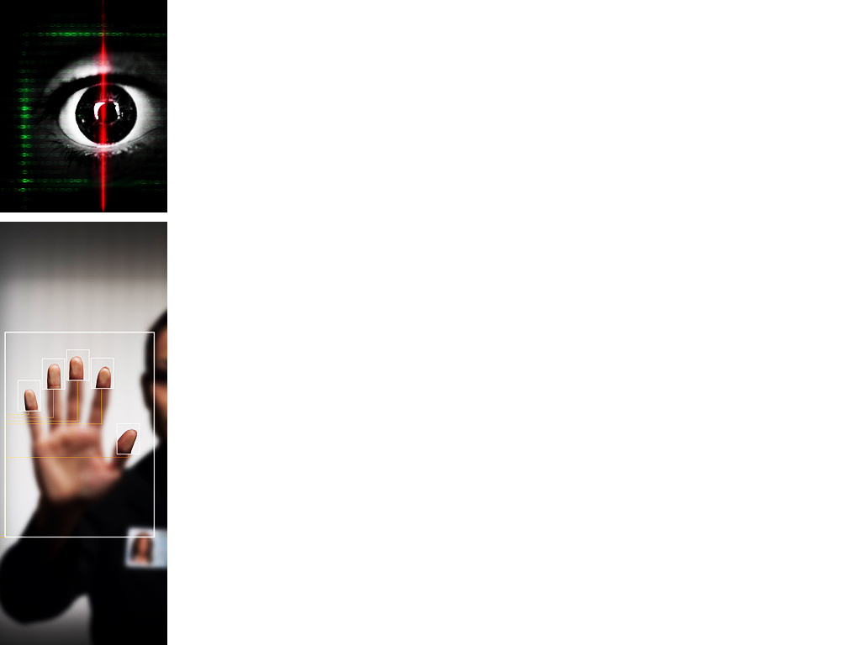

PIXELS
Pixels in face detection refer to the tiny building blocks of a digital image. They are like little dots that make up the picture. Each pixel holds information about its color and brightness. When we talk about face detection, we use special techniques to study the arrangement and qualities of these pixels. By looking at how they are organized and what makes them different, we can figure out if there is a face in the image or video. It's like solving a puzzle by examining the patterns and clues in these pixel dots.
In FaceVision, we use pixels because they provide us with crucial information about the image. Pixels are like puzzle pieces that help us understand the visual content. By analyzing the arrangement and characteristics of these pixels, we can identify patterns that indicate the presence of a face. By studying these tiny dots, we can unlock the hidden secrets of an image and determine whether or not there is a face within it.

Slide 4
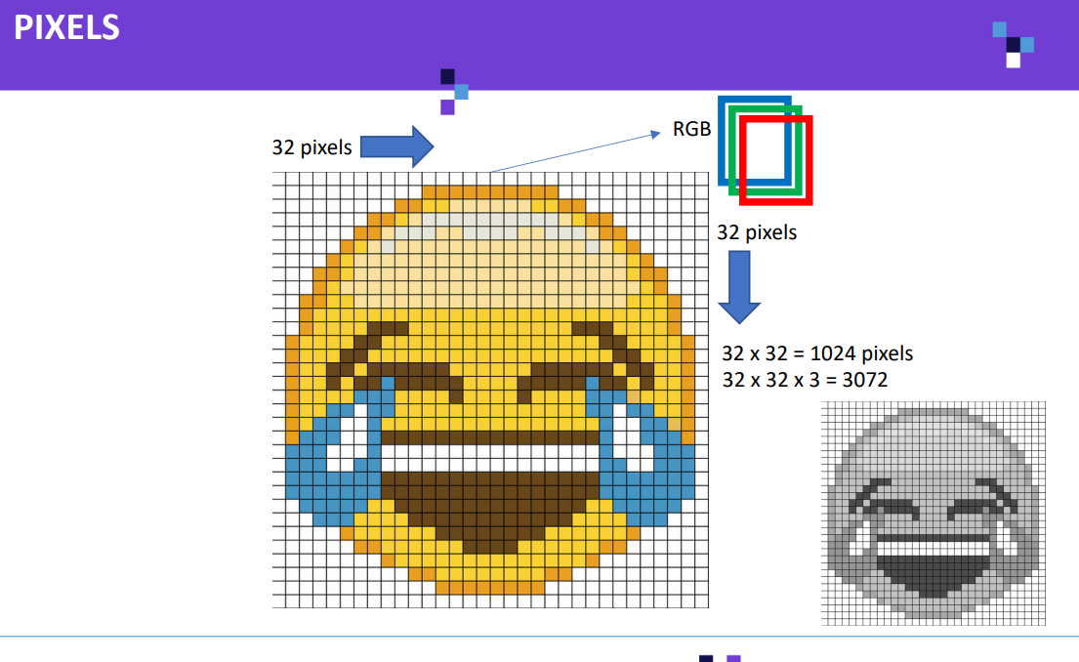
RGB in pixel refers to the three primary colors: Red, Green, and Blue. These colors combine to create all the colors you see on your screen. Each pixel has values for how much red, green, and blue light it emits, determining its final color. By adjusting these values, we can create a wide range of vibrant colors in digital images.

Slide 5
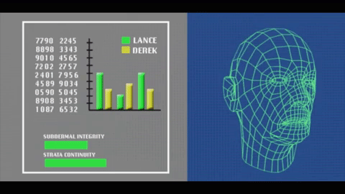
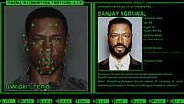

Slide 6

Haar Features
Haar features are simple patterns used in computer vision to detect objects like faces. They capture information about contrast and texture in an image. There are different types of Haar features:
Edge Features: These look for contrasting edges between adjacent regions.
Line Features: These detect lines of a specific direction and contrast.
Four-Rectangle Features: These calculate the difference in pixel intensity between two adjacent rectangular regions.
Three-Rectangle Features: Similar to four-rectangle features, but with a third region subtracted.
Center-Surround Features: These compare the pixel intensity in a central region with that of a surrounding region.
By combining these various Haar features, we can effectively identify patterns and objects in images.
Ref. Video Link :- https://www.youtube.com/watch?v=F5rysk51txQ

Slide 7
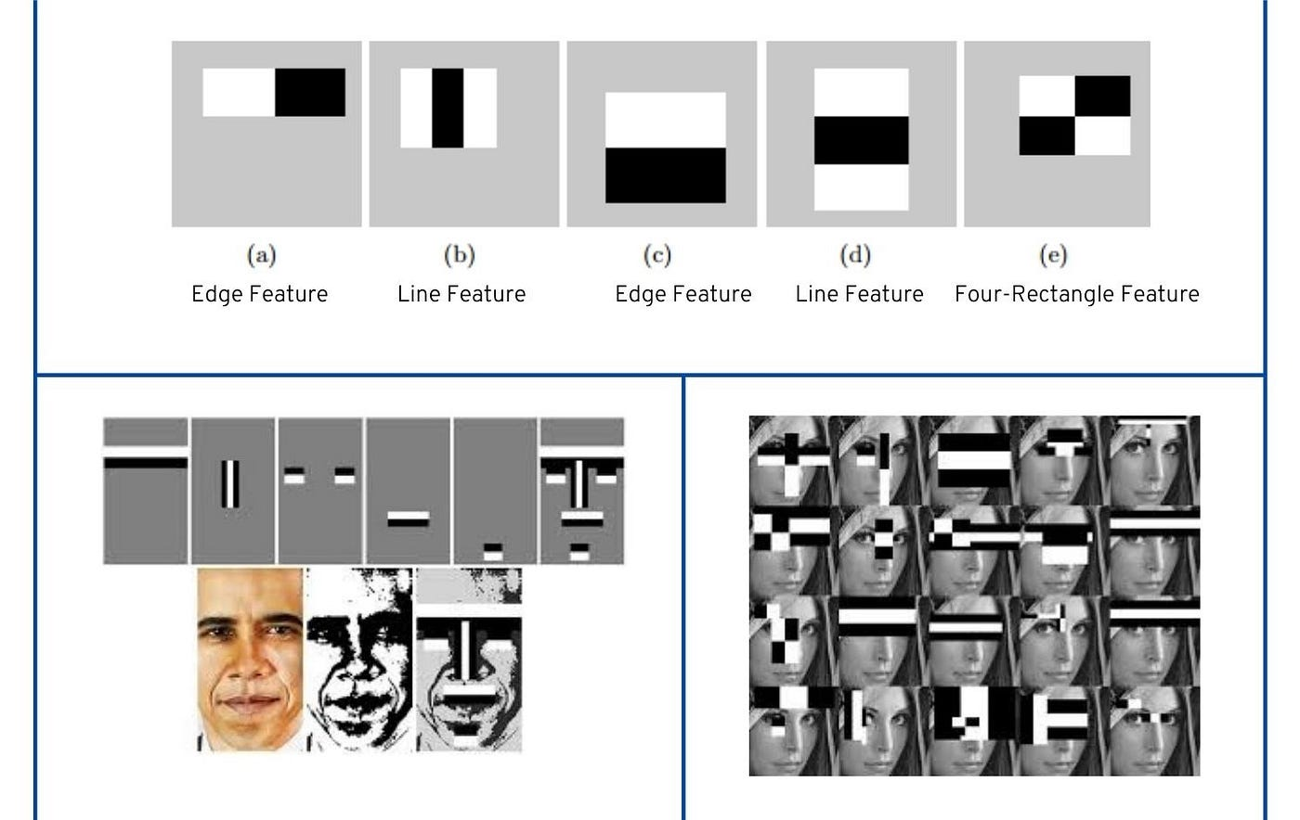

Slide 8
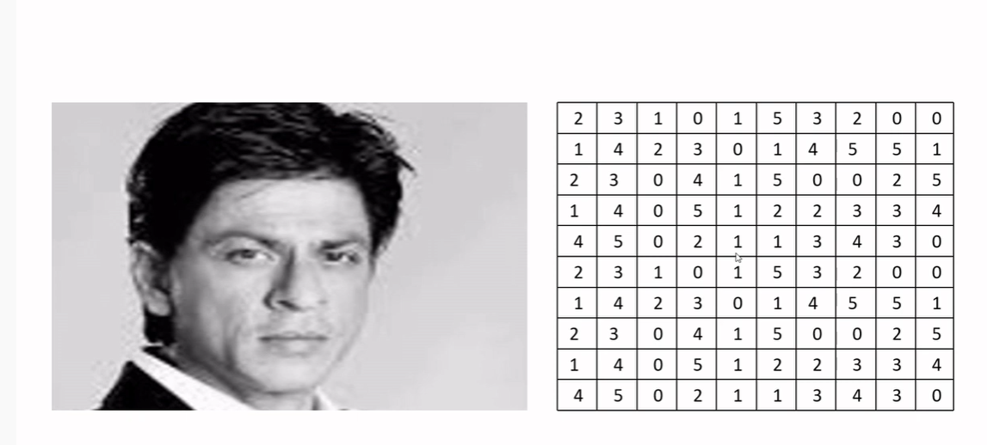
Create the Matrix with a Pixel value range from 0 to 255 (0 White and 255 Black )
Pixel is the smallest element of an image. Each pixel corresponds to anyone value. The value of the pixel is between 0 and 255. The value of a pixel at any point corresponds to the intensity of the light photons striking at that point.

Slide 9
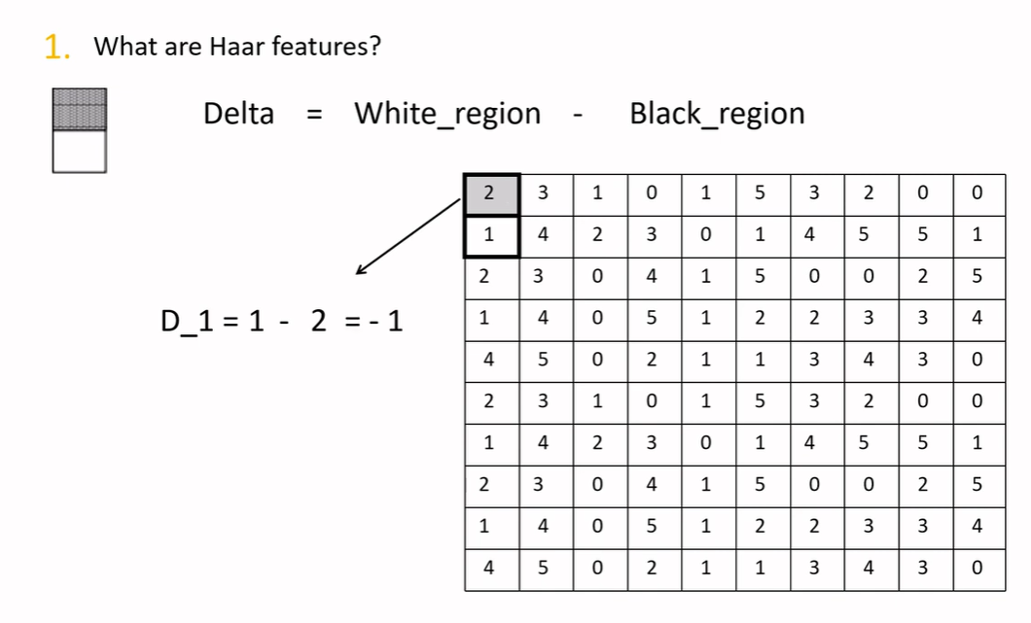

Slide 10
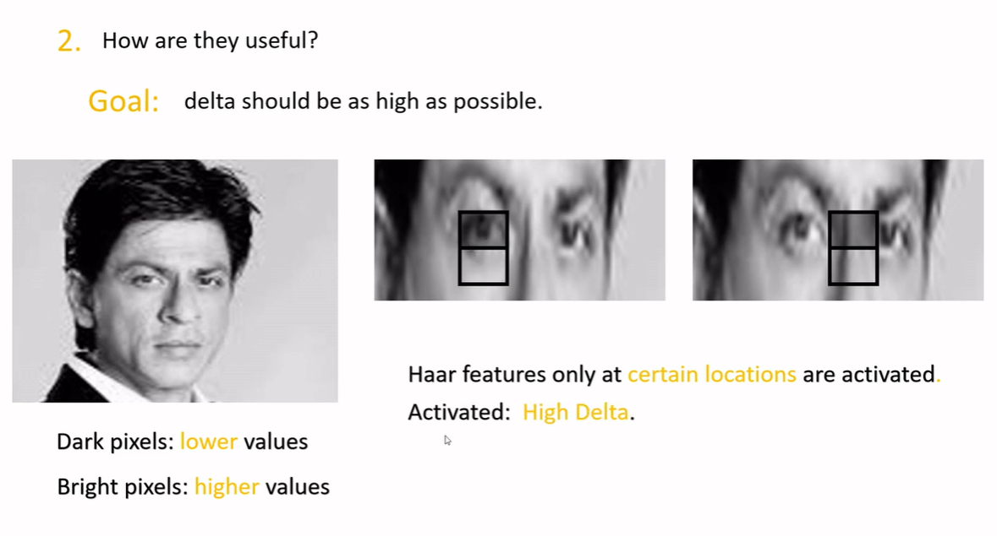

Slide 11
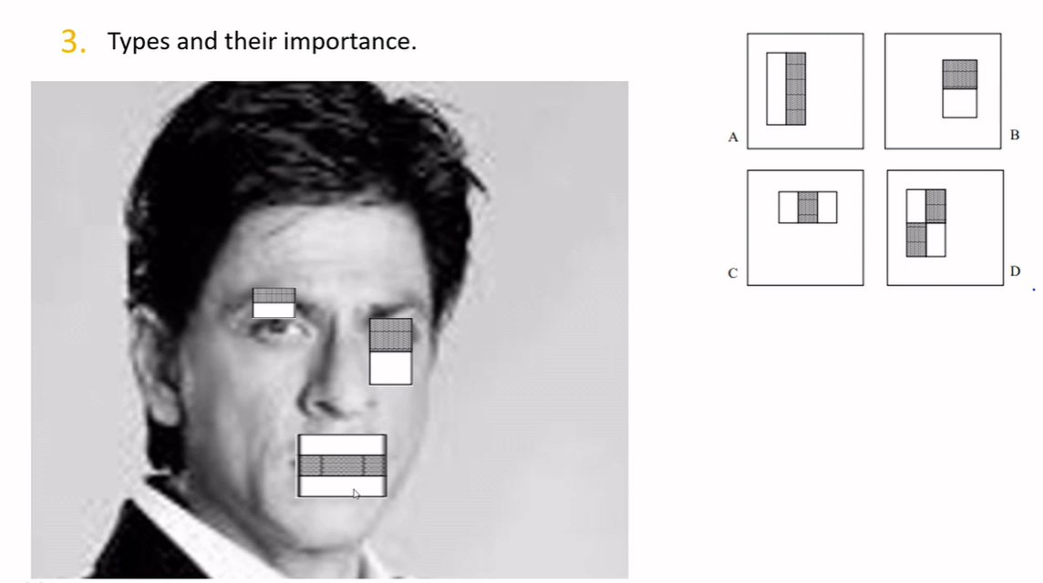

Slide 12
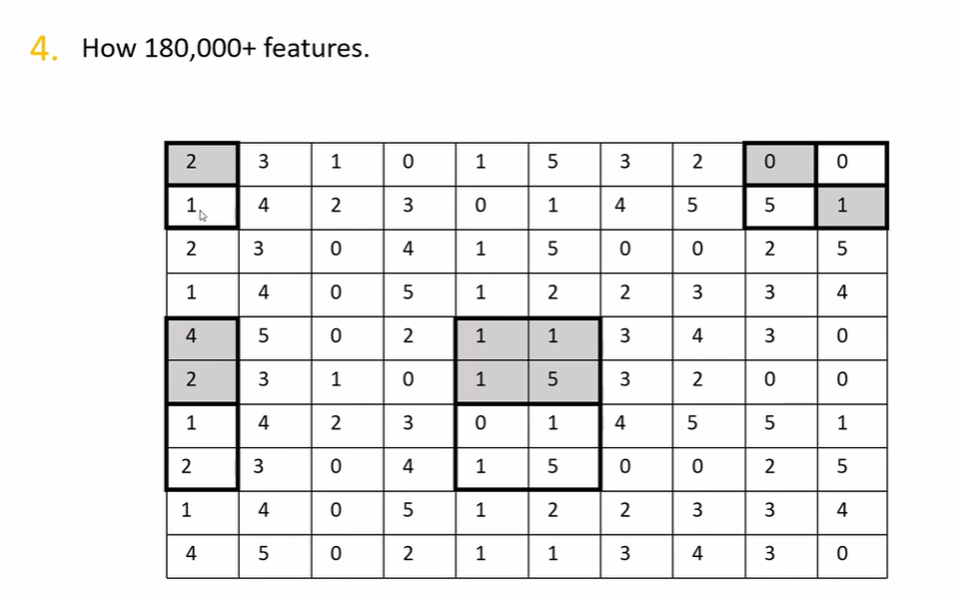

Slide 13
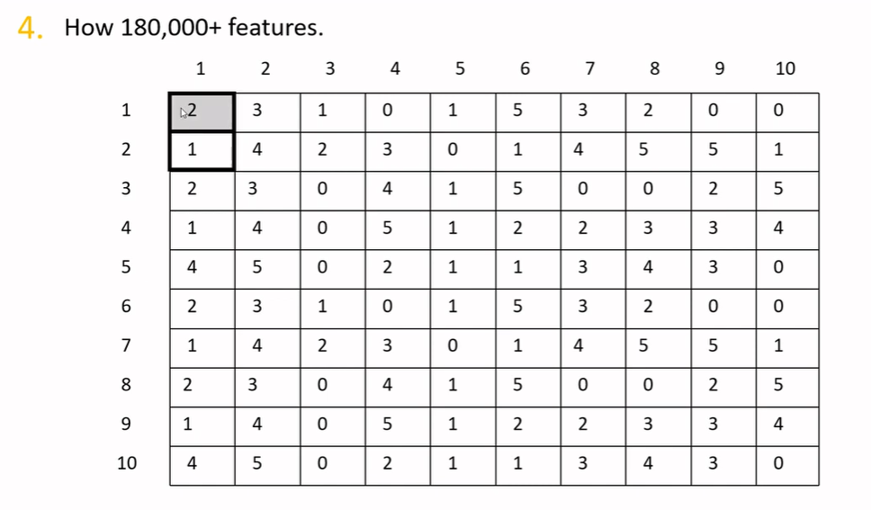

Start the feature mapping at the first position, then move to the second position.

Slide 14
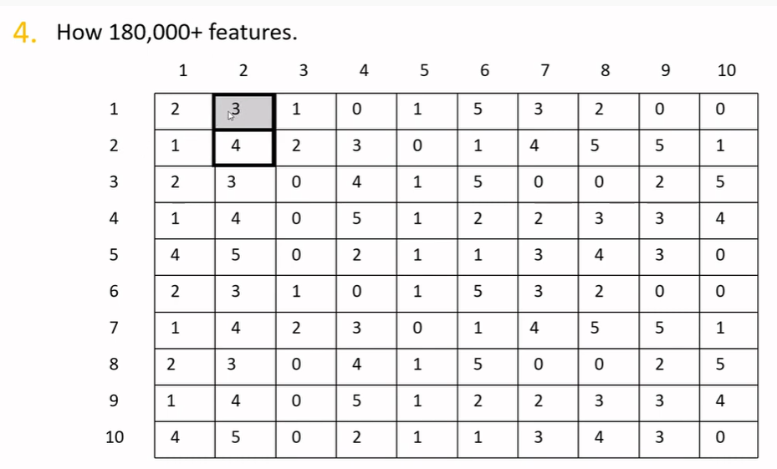
Feature mapping at second position.

Slide 15
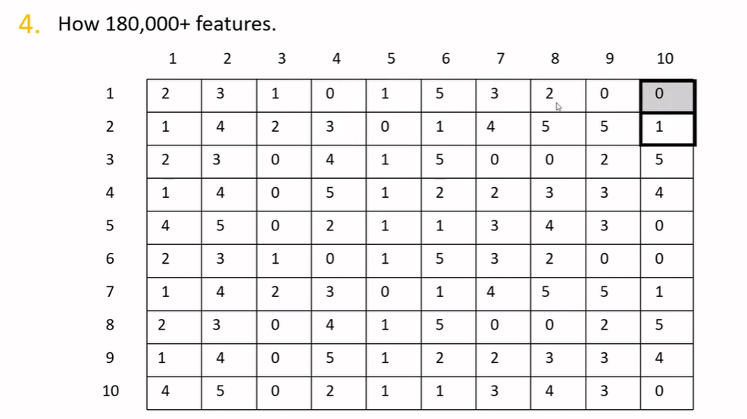
Then move till the end.

Slide 16
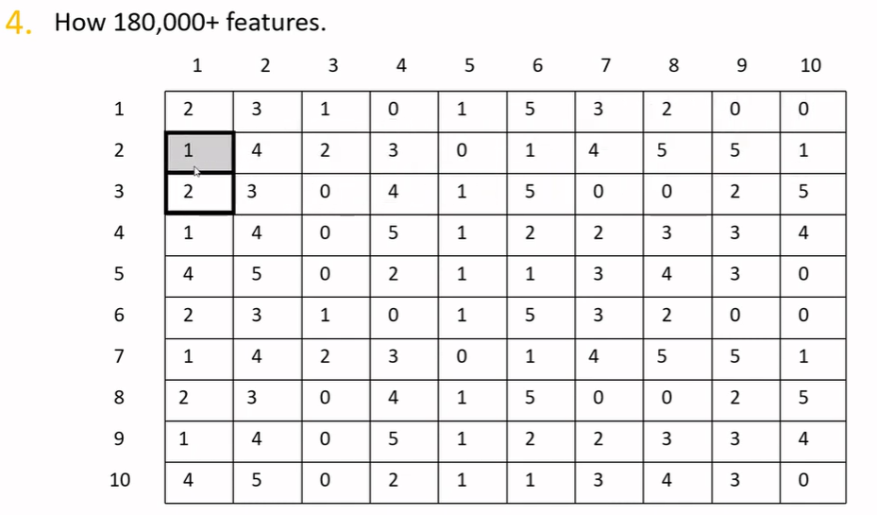
Then continue with the next row.

Slide 17
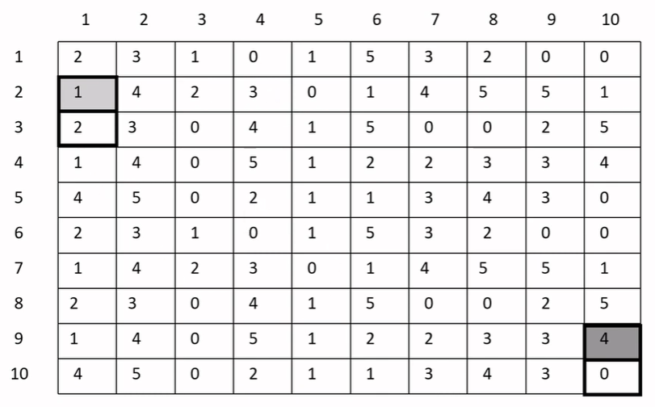
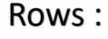
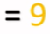
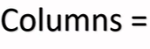

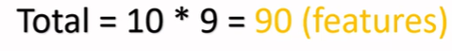
Continue the same till end. It need to scan through 9 rows & 10 columns.

Slide 18
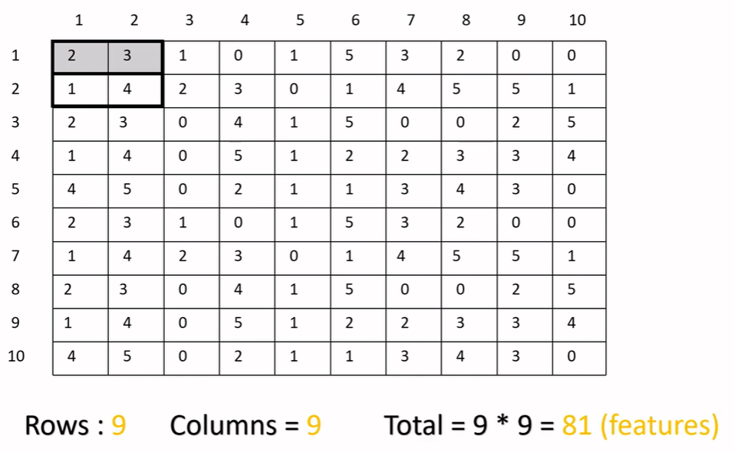

Slide 19
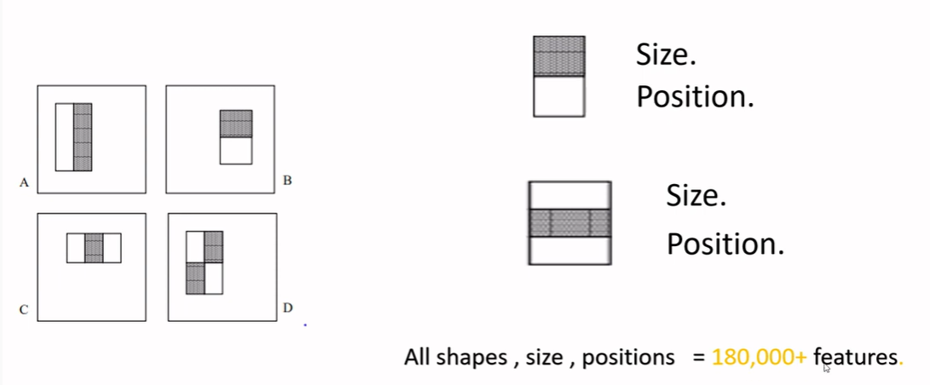
Once we combine all features and all combinations, we get 180,000 features.

Slide 20
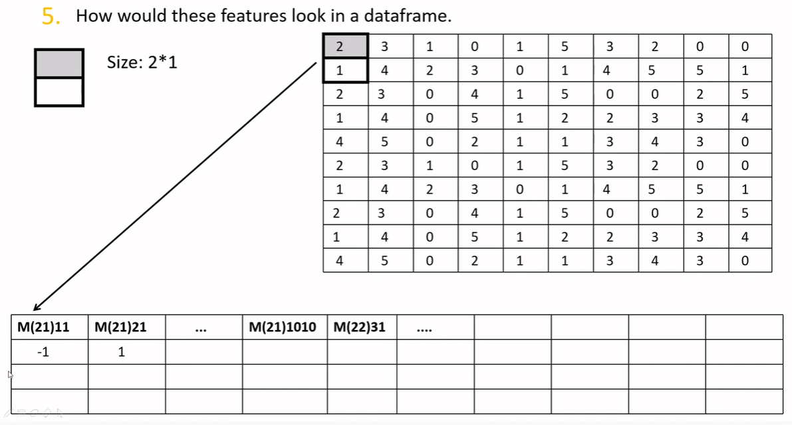

For the feature below (2 rows and 1 column), the delta value is entered data frame.

Slide 21
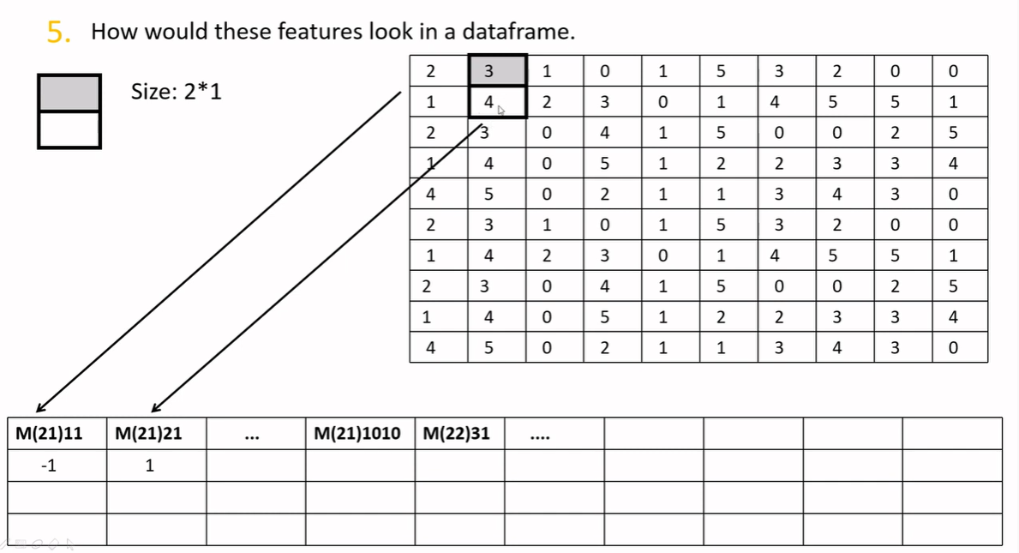

Slide 22
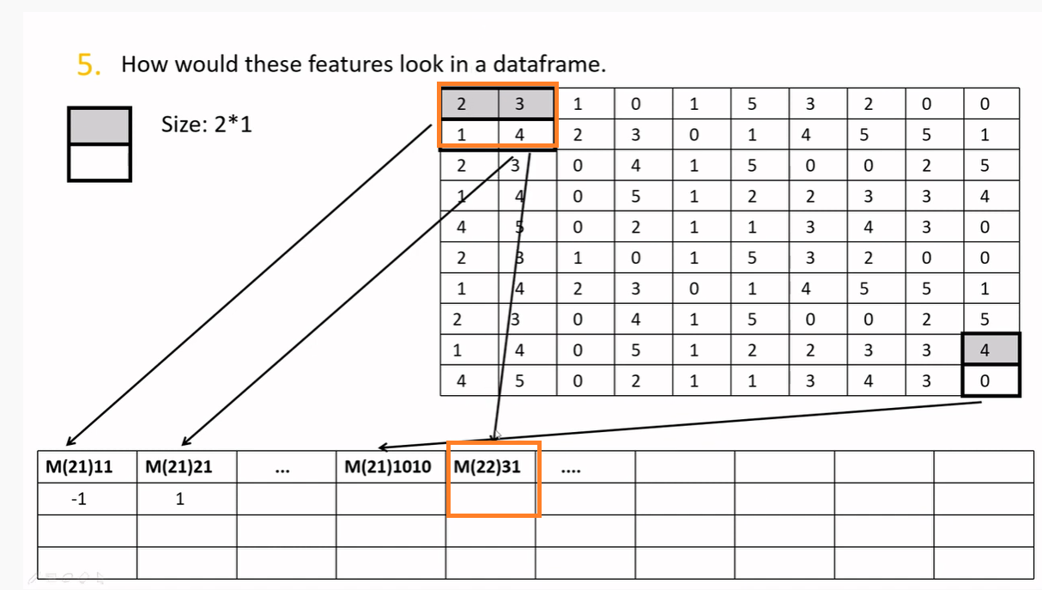
Now Matrix for another feature :-

Slide 23
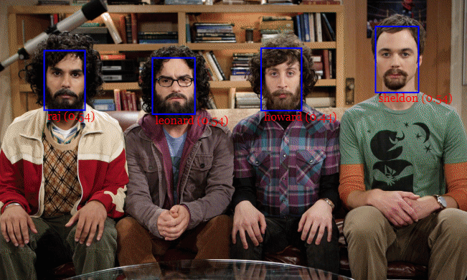

Face Detection in Computers
Slide windows of different sizes across image.
At each location match window to face model.
Wherever there is a match it is getting highlighted

Slide 24
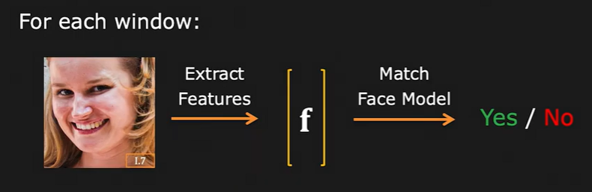
Face Detection Framework
Deifinition :- A face detection framework is a system to automatically identify and locate human faces in images or video frames.
Features :- Which features represents faces well ?
Classifier :- How to construct a face model & efficiently classify features as face or not ?

Slide 25
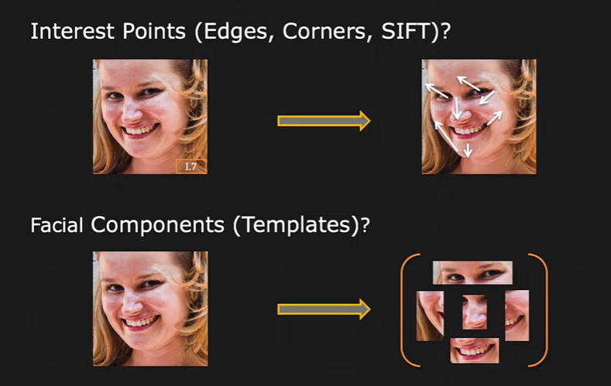
What are good features ?
Good features for face detection include interest points such as eyes, nose, and mouth, as well as facial components like eyebrows, lips, and the contour of the face.
These features provide distinctive characteristics that help in accurately identifying and detecting faces in images or video frames.

Slide 26
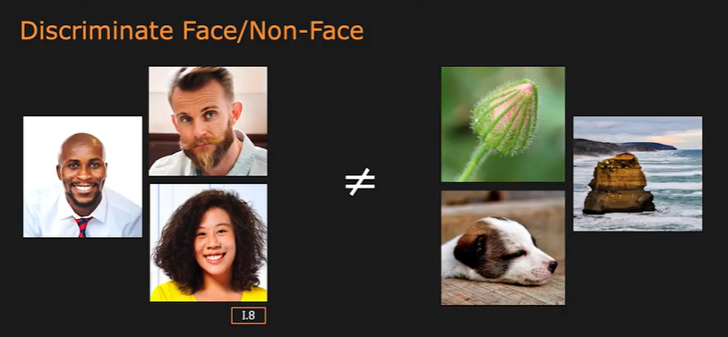
Characteristics of Good Features
Good features for face detection exhibit certain characteristics that make them effective in the task. These characteristics include high distinctiveness, robustness to variations in lighting and pose, repeatability across different instances of the same face, and invariance to non-face regions. Additionally, good features should have a low computational cost and be efficiently calculable.

Slide 27
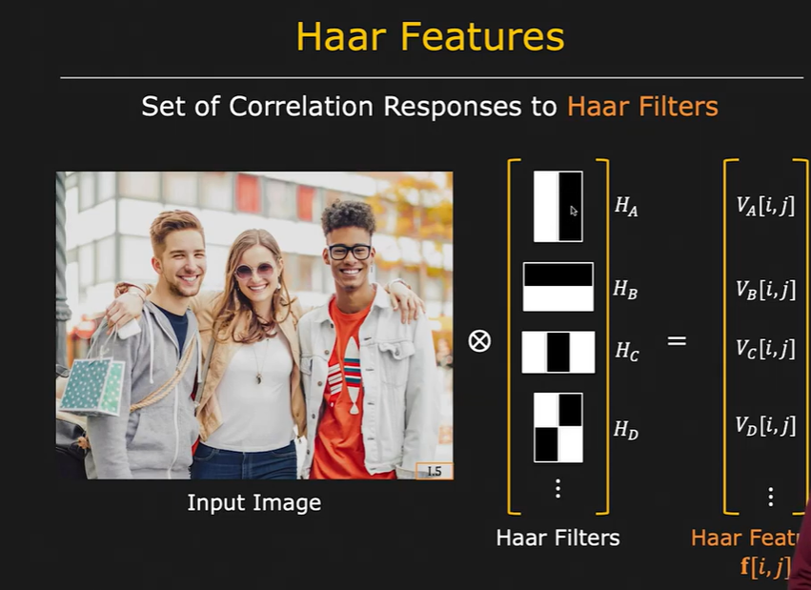

Slide 28
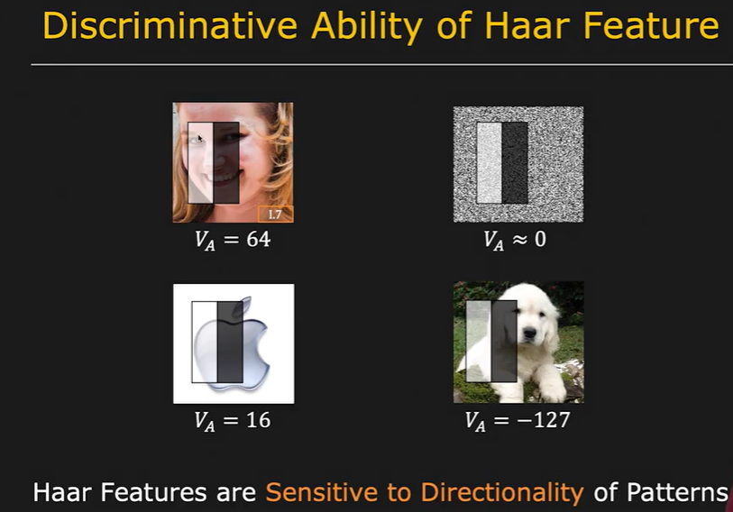

Slide 29
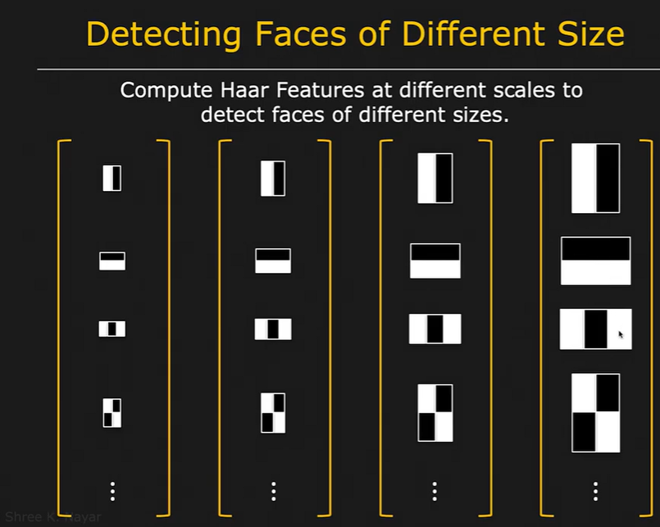

Slide 30
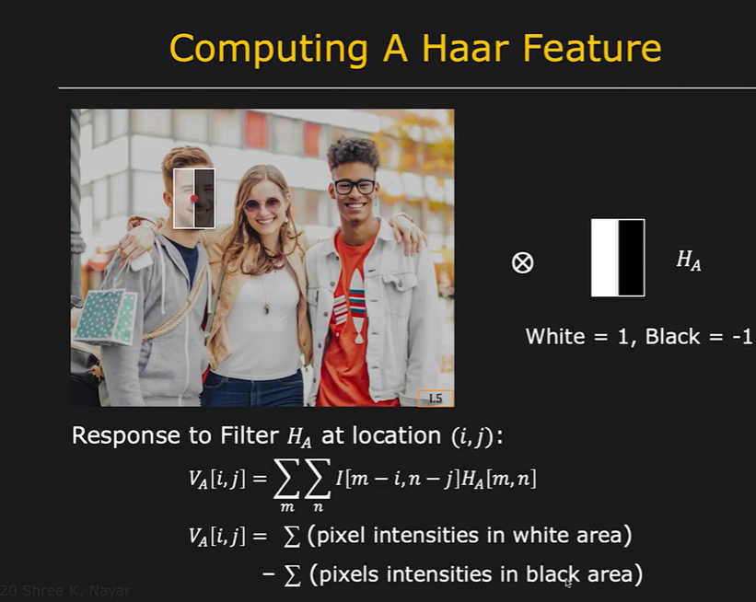

Slide 31
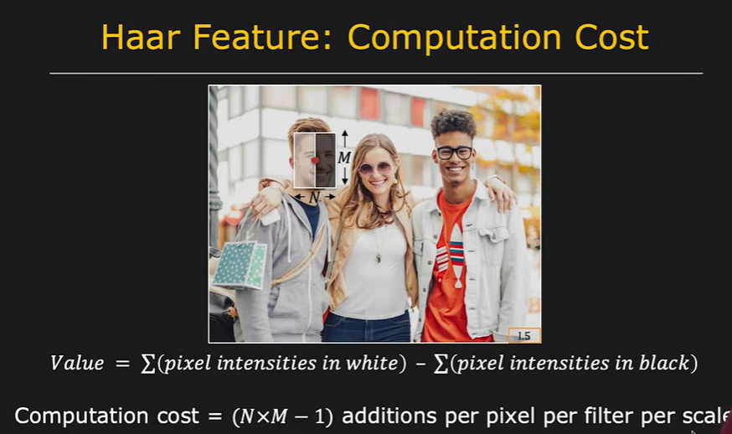

Slide 32
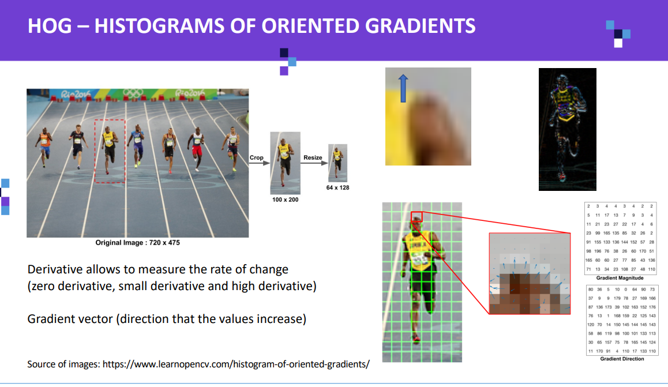

Slide 33
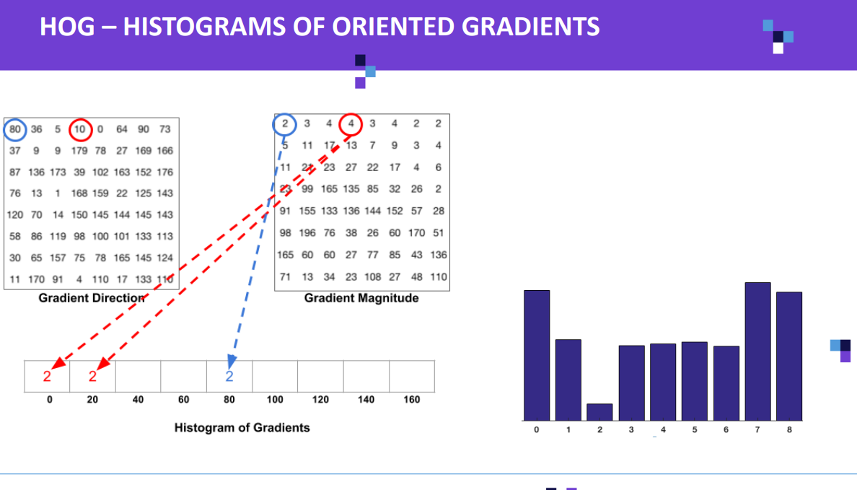

Slide 34
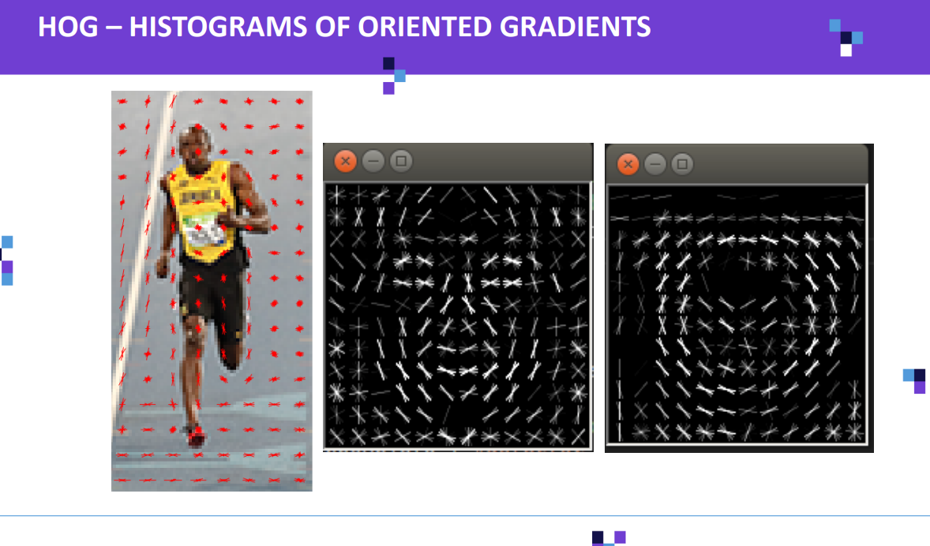

Slide 35
